Slide 1

Raspberry Pi and You

Slide 2
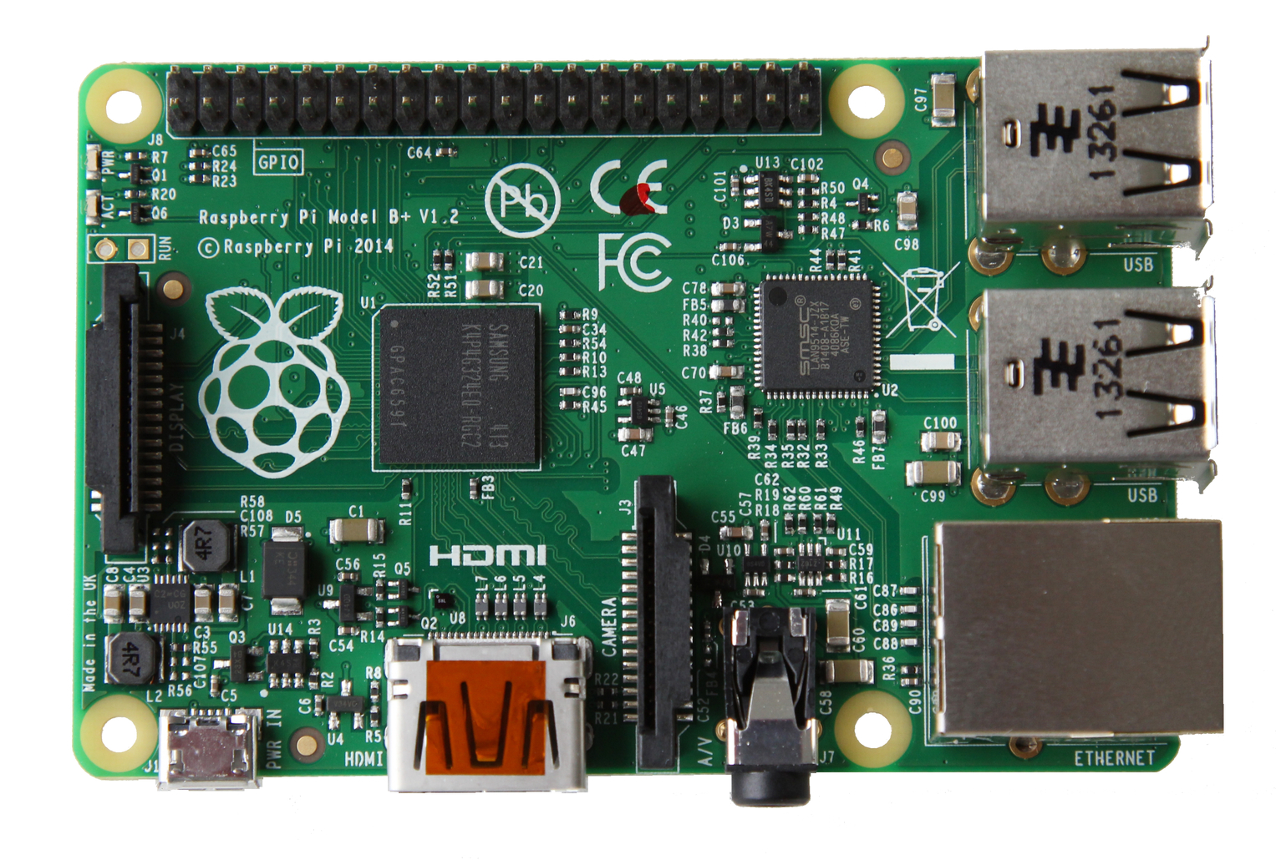
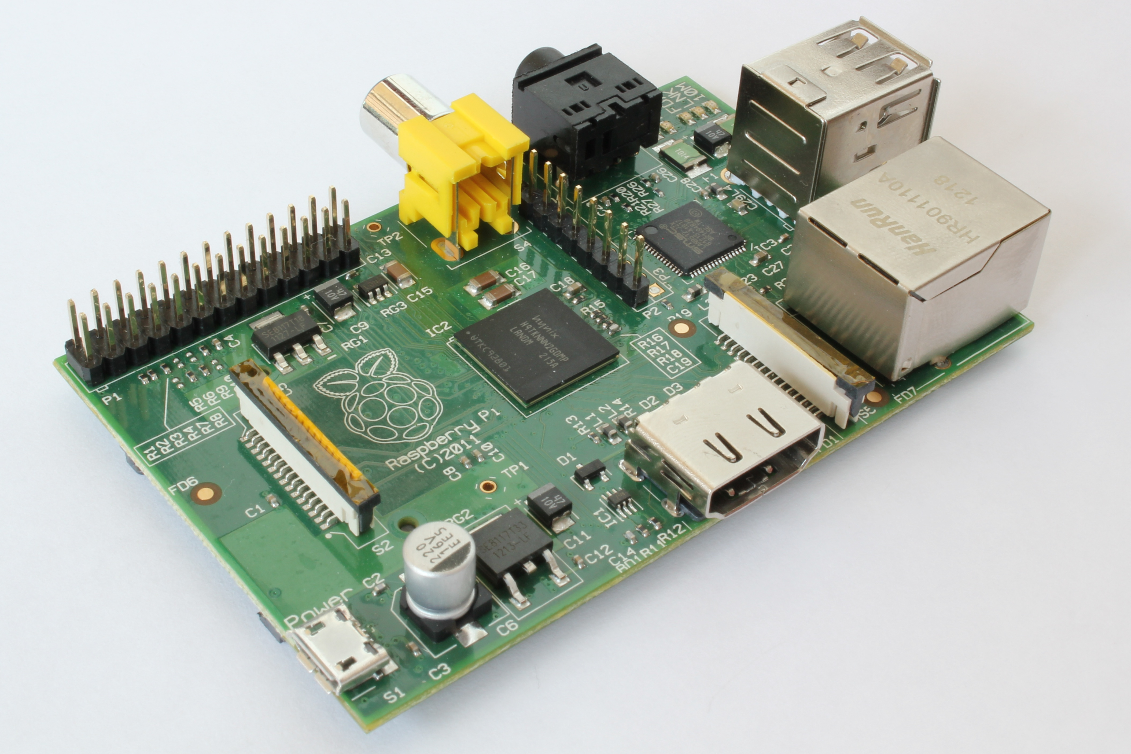
What is the Raspberry Pi?
Raspberry Pi 1 Model B+
Specs
A 700 MHz Single-Core Arm CPU
512MB RAM
4 USB Ports
40 GPIO pins
Full HDMI port
Ethernet port
Combined 3.5mm audio jack and composite video
Camera interface (CSI)
Display interface (DSI)
Micro SD card slot
VideoCore IV 3D graphics core
Raspberry Pi 2 Model B+
Specs
A 900MHz Quad-Core ARM Cortex-A7 CPU
1GB RAM
4 USB Ports
40 GPIO pins
Full HDMI port
Ethernet port
Combined 3.5mm audio jack and composite video
Camera interface (CSI)
Display interface (DSI)
Micro SD card slot
VideoCore IV 3D graphics core

Slide 3
What Makes it Unique?
A Cheap Computer
An Efficient Work Computer
Room for Expandability
Mathematica comes for Free
Operating System Cost is Free
Takes up only 2-4 Watts of Power
Sizes are 3.370 inches x 2.224 inches
Notes:
Be sure to cover in this section the comparison to Mac OS X and Windows 8.1.
Be sure to reference that the size of a Raspberry Pi is the size of a credit card.

Slide 4
Linux (Raspian vs Windows 8.1 vs Mac OS X Yosemite)

Slide 5
Office Work
Emails
Thunderbird
Evolution
Other Open Source Email Clients
Office Suite
LibreOffice Suite
OpenOffice Suite
Google Docs
KOffice
Printing
Samba Print Server
CUPS Printer Sharing
Google Cloud Print
Internet
Mozilla Firefox
Google Chrome
Opera
Sea Monkey

Slide 6
Developer Work
IDE's (Integrated Development Environments)
Eclipse
Netbeans
Adobe Brackets
Terminal
Code:Blocks
NinjaIDE
Aptana Studio
Notepad++
Terminal
Netstat
Compilers such as GCC and G++
Server Software
Web Server – Apache2
File Server – Samba,
Database – MySQL
Text Editors

Slide 7
Cost

Slide 8
Security

Slide 9
Stability

Slide 10
Recommendations

